Slide 1
IILM UNIVERSITY, GREATER NOIDA
JOB SIMULATION REPORT PRESENTATION
Mastercard
Cybersecurity Job Simulation
Hosted on the Forage Virtual Experience Platform
Mohd Ali Haider
Roll No. 2410030327 | B.Tech CSE
September 2026

Slide 2
ABOUT THE STUDENT
Candidate Profile
Roll Number
2410030327
Mohd Ali
Haider
Institute
IILM University, Greater Noida, U.P.
Programme
B.Tech – Computer Science & Engineering
B.Tech CSE, Batch 2024–2028
Simulation
Mastercard Cybersecurity Job Simulation (Forage)
Completed
September 2026
Mastercard Cybersecurity Job Simulation • Mohd Ali Haider
2

Slide 3
ABOUT THE PROGRAM
Forage & Mastercard
Forage is a virtual work-experience platform that partners with global employers so students can practise realistic, on-the-job tasks free of cost. Mastercard sponsors its Cybersecurity Job Simulation on Forage, giving participants an inside look at how its Security Awareness team designs phishing-awareness exercises and uses the results to protect employees from social-engineering attacks.
F
M
S
Forage Platform
Mastercard Sponsored
Security Analyst Role
Free, self-paced virtual work experiences designed with real employers.
Simulation designed and sponsored by Mastercard's Security Awareness team.
Participants take on the perspective of a Security Analyst tackling phishing risk.
Mastercard Cybersecurity Job Simulation • Mohd Ali Haider
3

Slide 4
PROBLEM STATEMENT
Why Phishing Awareness Matters
Phishing remains one of the most common and effective ways cybercriminals gain a foothold inside an organisation. Defending against it depends as much on employee awareness as on technical controls — yet most students only encounter phishing as a term from coursework, with little hands-on exposure to how a real security team designs and interprets an awareness exercise.
This simulation addressed that gap through two practical, hands-on tasks:
Analyze a
Sample Email
→
Design a Realistic
Phishing Simulation
→
Interpret the
Simulation Results
→
Recommend
Targeted Training
Mastercard Cybersecurity Job Simulation • Mohd Ali Haider
4

Slide 5
SIMULATION OBJECTIVES
What the Simulation Set Out to Achieve
!
Q
D
Understand the Threat
Recognise Red Flags
Mastercard's Approach
Learn what risk phishing poses to an organisation and its people.
Identify the characteristics that distinguish phishing emails from legitimate ones.
Understand how Mastercard prevents and mitigates phishing threats.
E
R
T
Design a Simulation
Interpret Results
Recommend Training
Turn an obvious fake email into a convincing awareness-testing exercise.
Read simulation outcome data to see where employees are most at risk.
Translate findings into targeted, prioritised awareness training.
Mastercard Cybersecurity Job Simulation • Mohd Ali Haider
5

Slide 6
SKILLS & TOOLS
What the Simulation Drew On
A
B
C
Security Awareness
Problem Solving
Design Thinking
Threat identification & analysis
Working through a realistic scenario
Crafting a believable test email
D
E
F
Communication
Data Analysis
Training Strategy
Documenting findings clearly
Reading simulation outcome data
Prioritising follow-up training
Mastercard Cybersecurity Job Simulation • Mohd Ali Haider
6

Slide 7
TASK 1
Designing a Phishing Email Simulation
Starting from a deliberately obvious, low-effort phishing email, the task was to identify the red flags a real employee would notice — a mismatched sender address, a generic greeting, urgent or threatening language, a suspicious link — and then revise the email so it would realistically test an employee's ability to spot a phishing attempt.
Reviewed sender details, links & tone of the sample email
Identified the specific red flags giving the email away
Rewrote the email to be more convincing for internal testing
Documented the revised email for the Security Awareness team
Mastercard Cybersecurity Job Simulation • Mohd Ali Haider
7

Slide 8
TASK 2
Interpreting Phishing Simulation Results
With the simulation run, the next task was to read the outcome data — who clicked the simulated link, who reported it as suspicious — and turn that into a practical recommendation on which teams most needed follow-up phishing-prevention training.
Reviewed simulated click / report data from the campaign
Identified employees and teams most at risk
Prioritised which teams needed training first
Recommended a targeted awareness-training plan
Mastercard Cybersecurity Job Simulation • Mohd Ali Haider
8

Slide 9
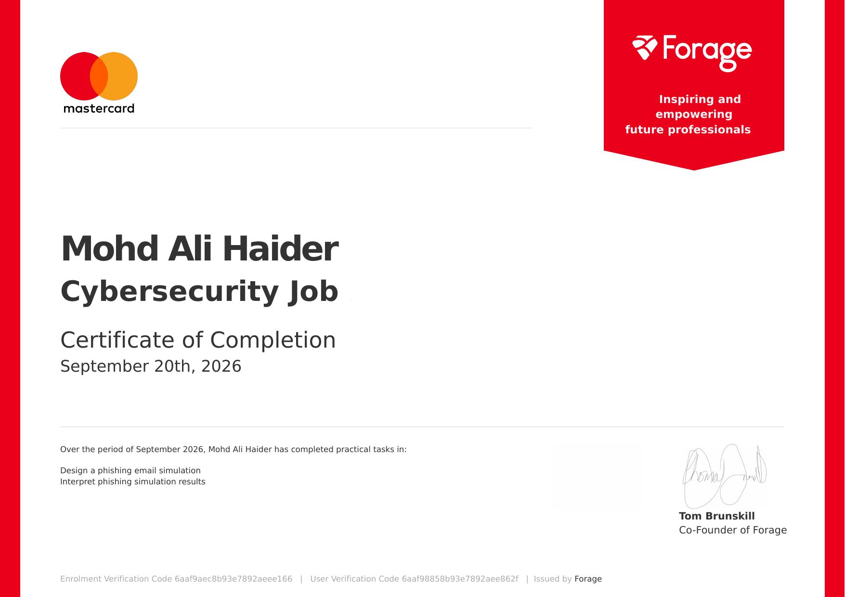
CERTIFICATION
Successfully Completed
Completed
September 2026
Enrolment Verification Code
6aaf9aec8b93e7892aeee166
User Verification Code
6aaf98858b93e7892aee862f
Issued By
Forage (countersigned by Tom Brunskill, Co-Founder)
Mastercard Cybersecurity Job Simulation • Mohd Ali Haider
9

Slide 10
Thank You
Mastercard Cybersecurity Job Simulation | Forage
Mohd Ali Haider
Roll No. 2410030327 | IILM University, Greater Noida

